Slide 1

Olympic data AnaLYSIS
(1896-2012)

Slide 2
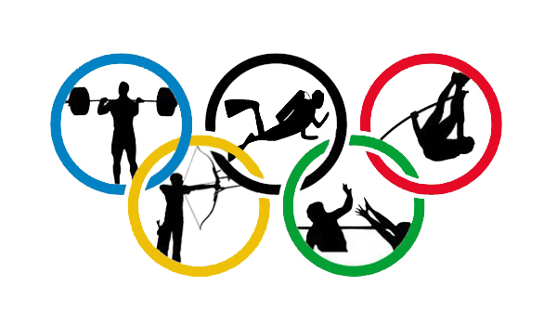
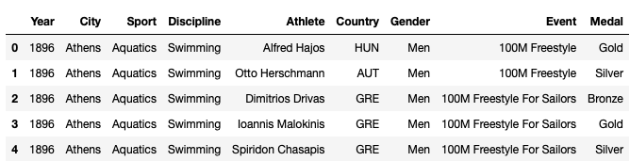
How our data looks:-

Slide 3
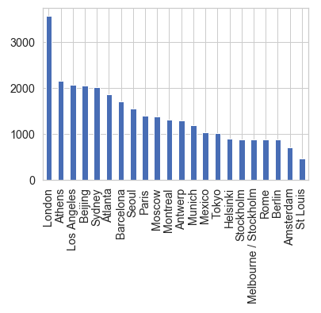
coUntries who hosted olympic past 100 years

Slide 4
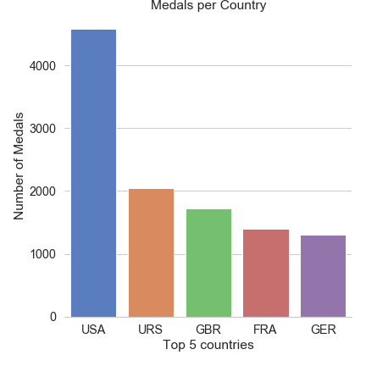
Top 5 decorated countries

Slide 5
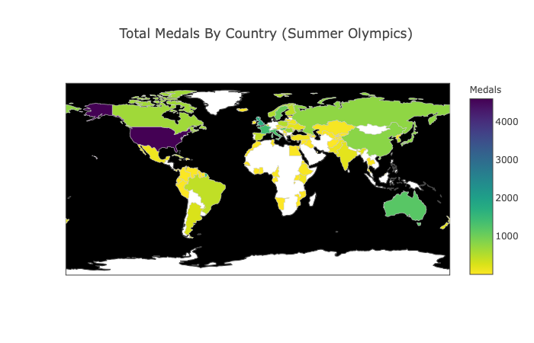
Total Medals By Country ACROSS THE WORLD (Olympics)

Slide 6
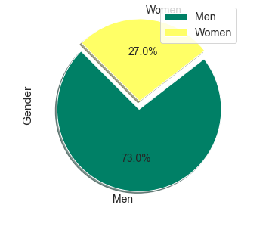
Pie chart showing the participation ratio on basis of gender

Slide 7
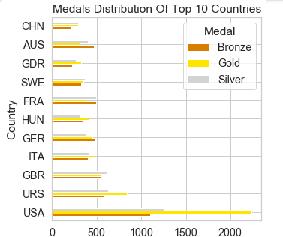
Medals Distribution Of Top 10 Countries

Slide 8
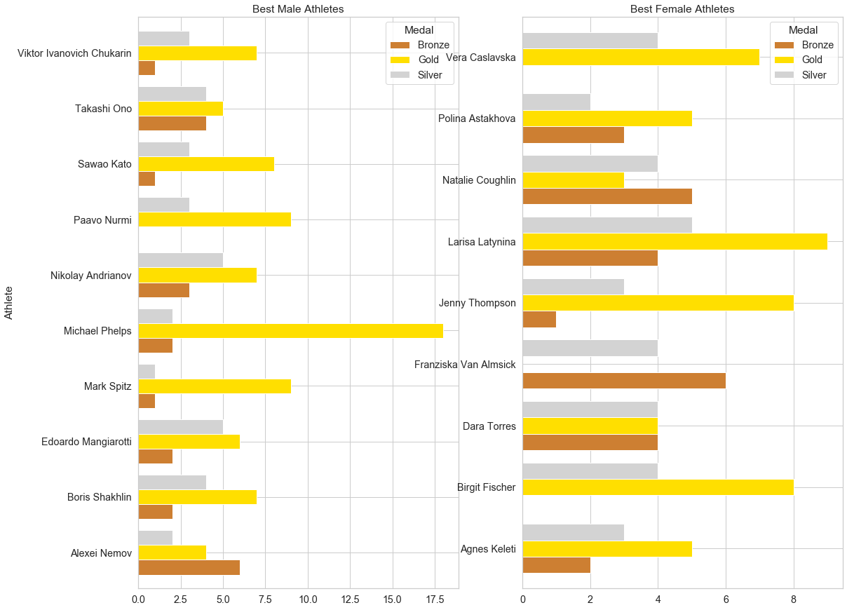
Best male Athletes & Best Female Athletes

Slide 9
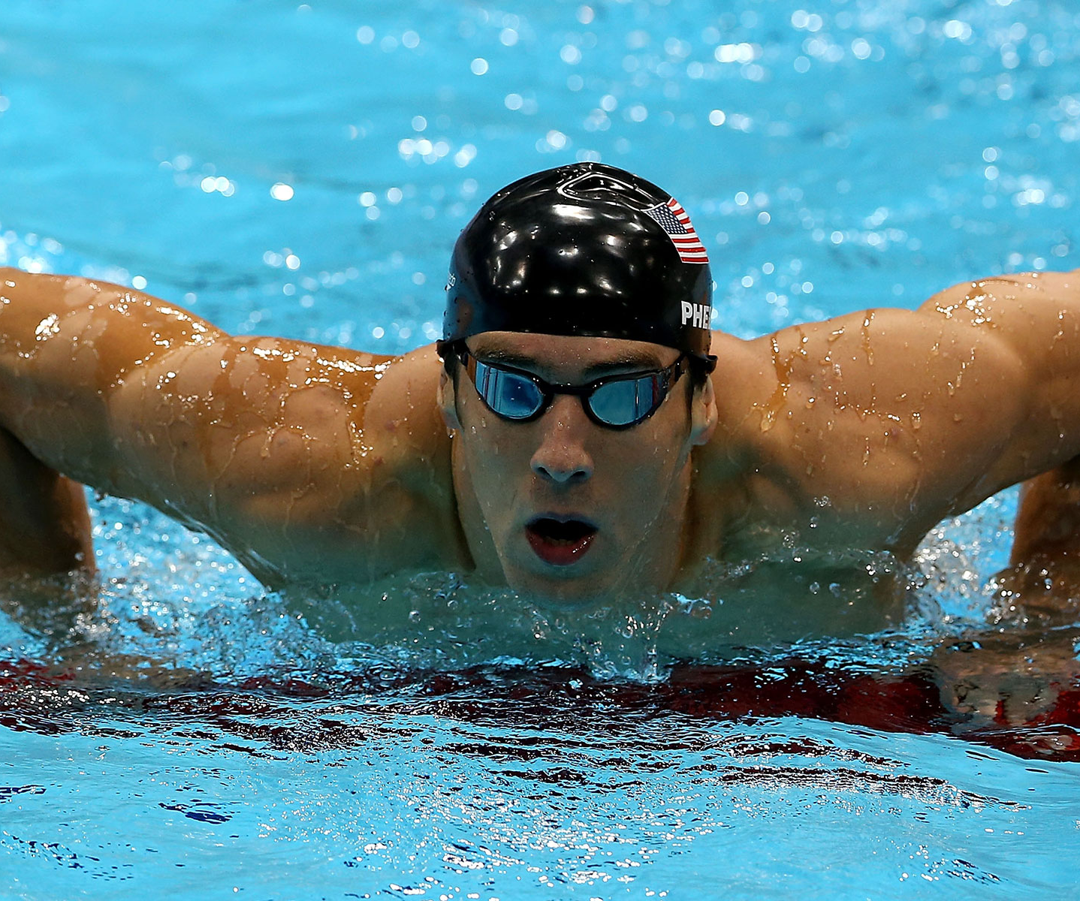
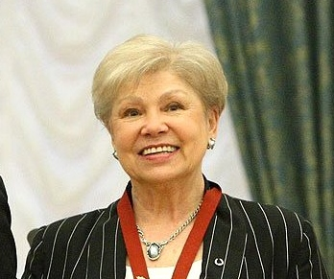
The Highest Decorated Male Athlete
Michael Phelps(Swimming)
The Highest Decorated Female Athlete
Larisa Latynina(Gymnast)

Slide 10
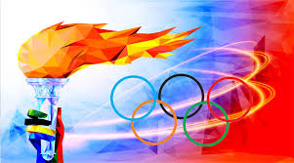
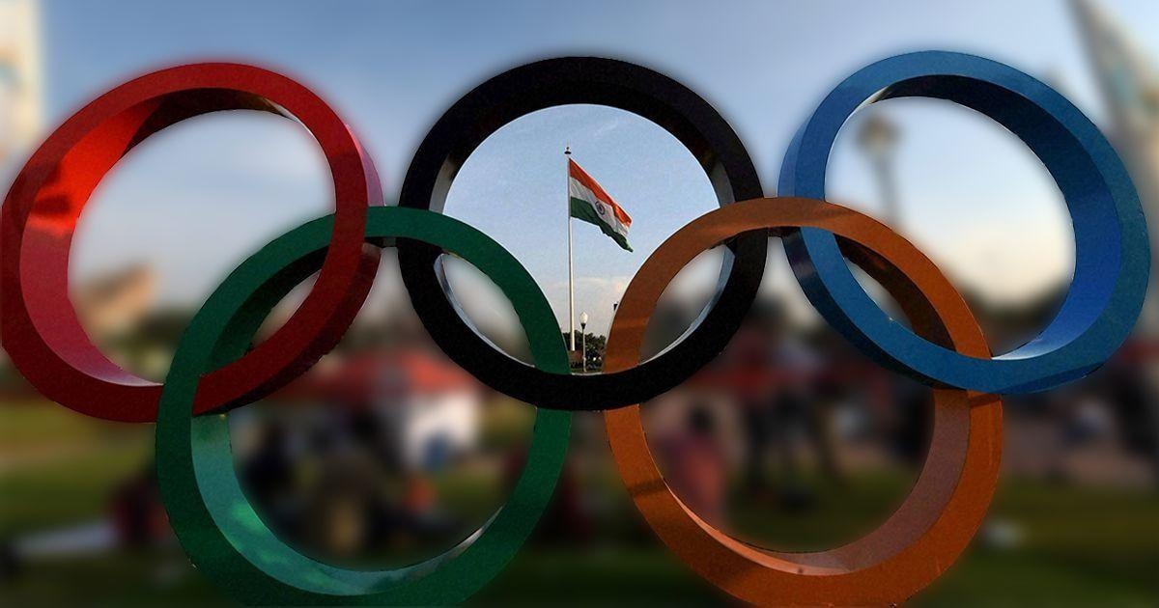
India in Olympics (1896-2012)

Slide 11
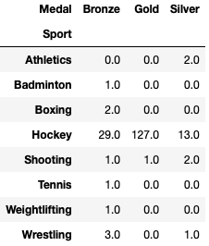
India in Olympics (1896-2012)
India’s Position(Ranking) -60
India’s have won 184 medals.
India’s Medal Tally

Slide 12
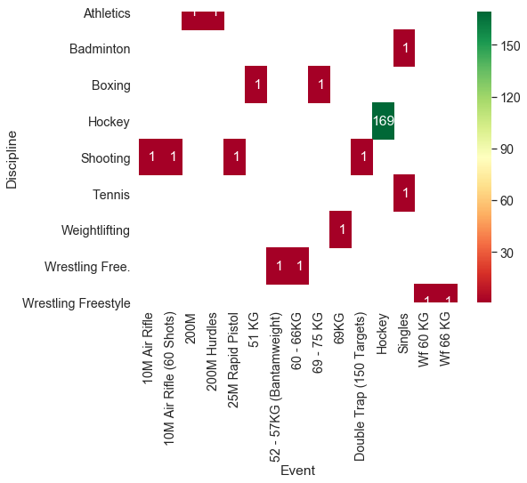
India in Olympics (1896-2012)

Slide 13
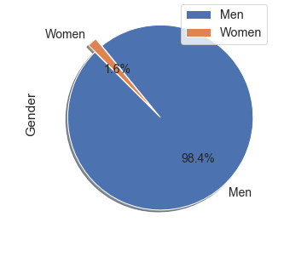
India in Olympics (1896-2012)
Pie chart showing the participation ratio on basis of gender

Slide 14
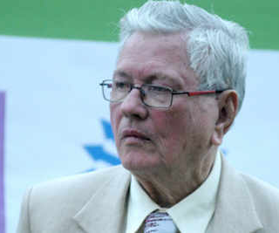

India in Olympics (1896-2012)
The Highest Decorated Male Athlete
-Leslie Walter Claudius(Hockey)
The Highest Decorated Female Athlete
Saina Nehwal(Badminton)

Slide 15
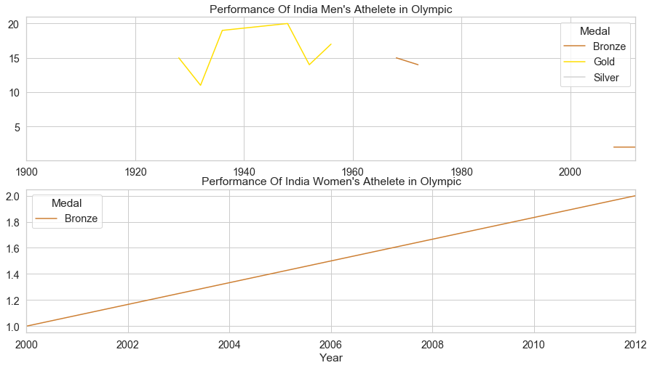
India in Olympics (1896-2012)

Slide 16
Thank You
-Paras

